Slide 1
Mastering Blockchain Third Edition
Chapter 2, Decentralization

Slide 2
Outline
Decentralization using blockchain
Methods of decentralization
Routes to decentralization
Blockchain and full ecosystem decentralization
Pertinent terminology
Platforms for decentralization
Innovative trends

Slide 3
Defining decentralization

Slide 4
Decentralization using blockchain

Slide 5
Differences between distributed and decentralized systems
Distributed
Decentralized

Slide 6
Methods of decentralization
Disintermediation
Contest-driven decentralization

Slide 7
How to decentralize
What is being decentralized?
What level of decentralization is required?
What blockchain is used?
What security mechanism is used?

Slide 8
Blockchain and full ecosystem decentralization
This model illustrates how a full decentralized ecosystem could work. It includes:
Communication
Storage
Computing power
Identity and wealth

Slide 9
Decentralized applications
Decentralized Applications (DApps) can be categorized into Type 1 (run on their own dedicated blockchain), Type 2 (use an existing public blockchain), or Type 3 (use the protocols of Type 2 DApps)
Requirements of a DApp
Fully open source
Operations must be cryptographically secured
Stored on a public ledger
Tokens to be generated under a consensus mechanism

Slide 10
Design of a DApp
Traditional client server model
Decentralized application

Slide 11
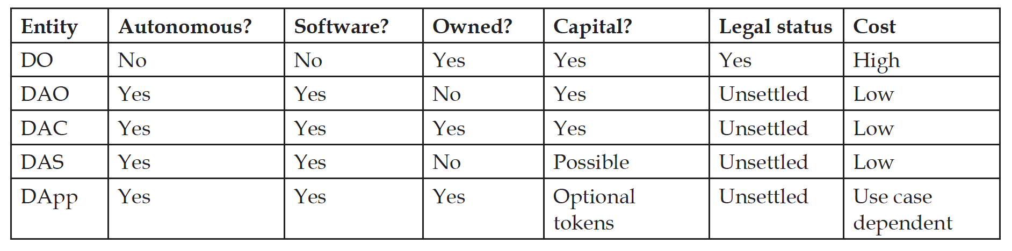
DO, DAO, DAC, DAS, DApp
The table highlights some key properties of some different types of decentralized entities; Decentralized Organizations (DOs), Decentralized Autonomous Organizations (DAOs), Decentralized Autonomous Corporations (DACs), Decentralized Autonomous Societies (DASes), and DApps

Slide 12
Platforms for decentralization
Ethereum
MaidSafe
Lisk
EOS

Slide 13
Innovative trends
Decentralized web
Web 1: the original World Wide Web
Web 2: the era when more service-oriented and web-hosted applications started to emerge
Web 3: the vision of the decentralized internet or web
Decentralized identity
Decentralized finance (DeFi)

Slide 14
Exercise
How can decentralization impact finance? Consider how blockchain technology could be implemented in existing financial processes.

Slide 15
Summary
In this presentation we:
Defined the concept of decentralization.
Introduced DApps, applications based on a decentralized architecture.
Considered decentralization from the blockchain perspective.
Looked at some key features of DAOs, DACs, and Dapps, among other decentralized entities.
Explored some innovative trends.

